Slide 1
NLP Chatbot using DialogFlow for Training Company

Slide 2
GitHub Repository Link
https://github.com/ImtananAhnaf/DialogFlow_Chatbot_Prototype.git

Slide 3
INTRODUCTION OF PROJECT
3
The primary purpose of the project is to develop an AI-powered chatbot specifically for a Training Company. This chatbot will streamline and automate various administrative tasks and student interactions, providing an efficient and user-friendly platform for handling inquiries. By leveraging Google DialogFlow’s advanced NLP capabilities, the chatbot aims to improve operational efficiency and enhance the user experience for students, staff, and prospective enrollees.

Slide 4
Requirements(functional)
4
Functional Requirements – Training Chatbot
1. Student Inquiry Handling
Answers FAQs about courses, fees, schedules, and trainers
Provides details on course content & certifications
2. Course Registration
Displays available courses for easy registration
Sends confirmation messages upon successful signup
3. Schedule Management
Provides class schedules & batch timings
Allows users to check upcoming & ongoing classes
4. Resource Distribution
Enables students to download brochures & training materials
5. Personalized Interaction
Recommends courses based on user interests & history
6. Management Tasks (Admin Panel)
Manage Course Catalog – Add, update, or remove course details

Slide 5
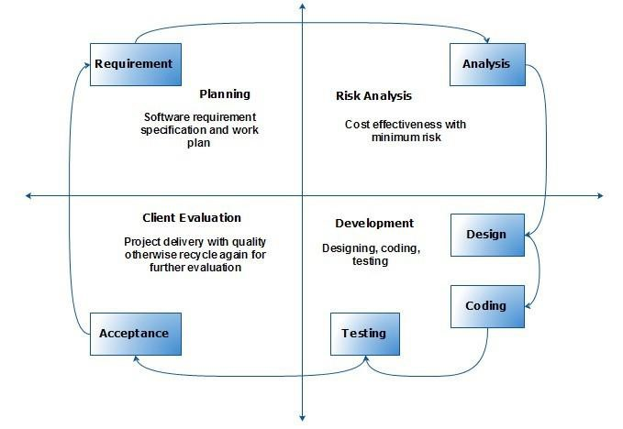
VU Process Model

Slide 6
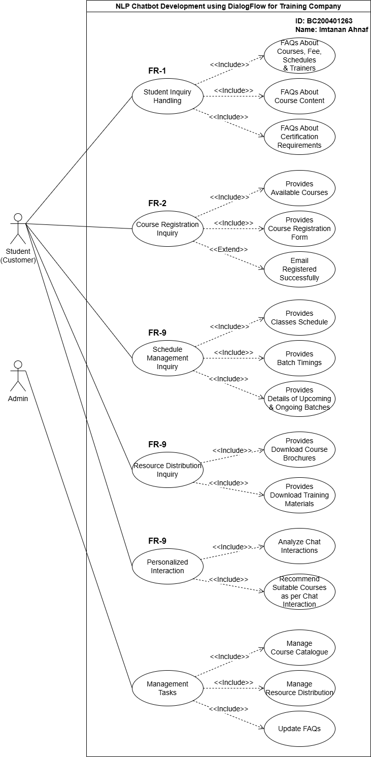
Use Case Diagram

Slide 7
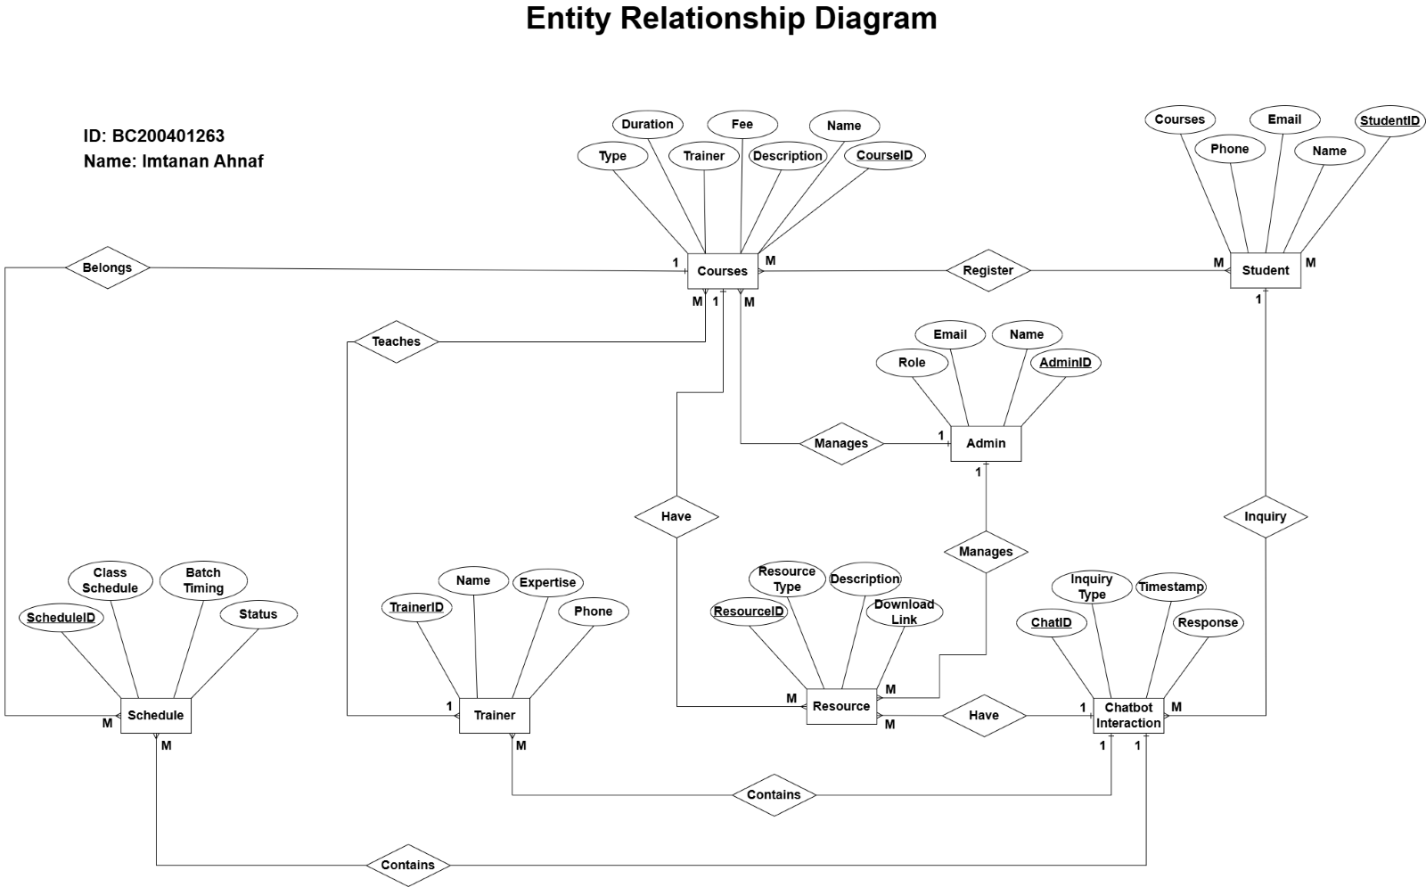

Slide 8
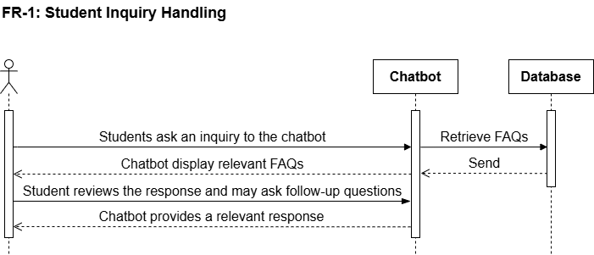
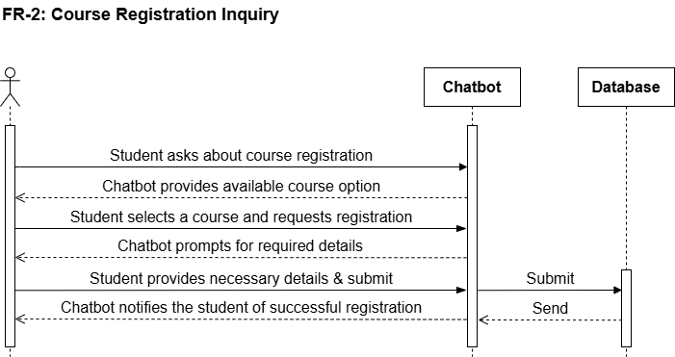
Squence Diagram

Slide 9
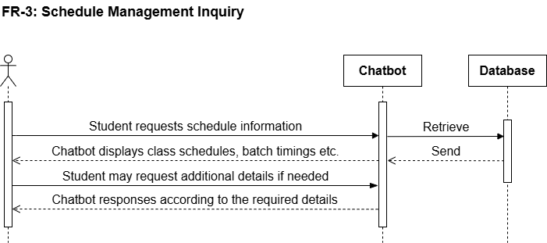
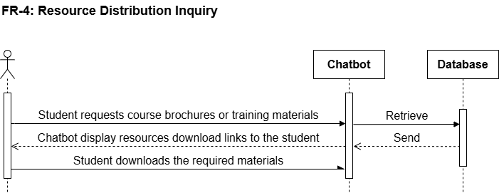

Slide 10
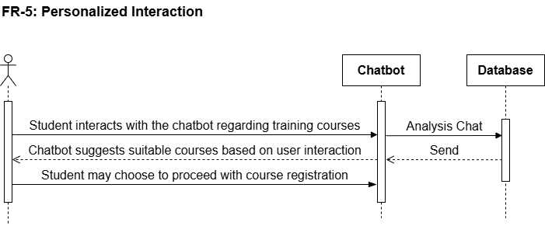
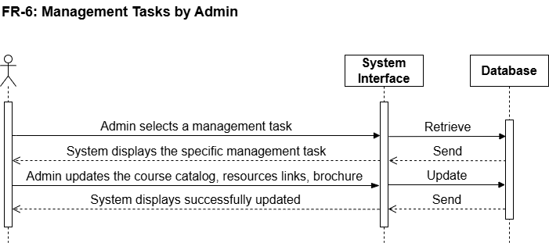

Slide 11
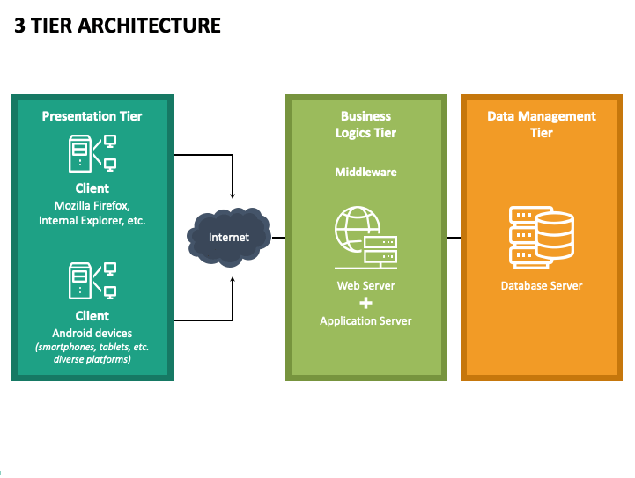
Architecture Design Diagram

Slide 12
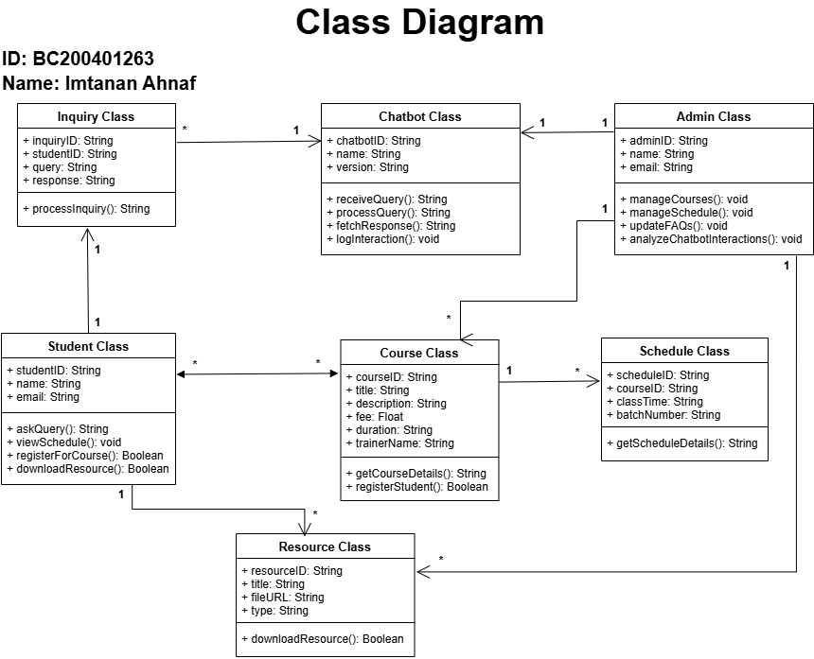

Slide 13
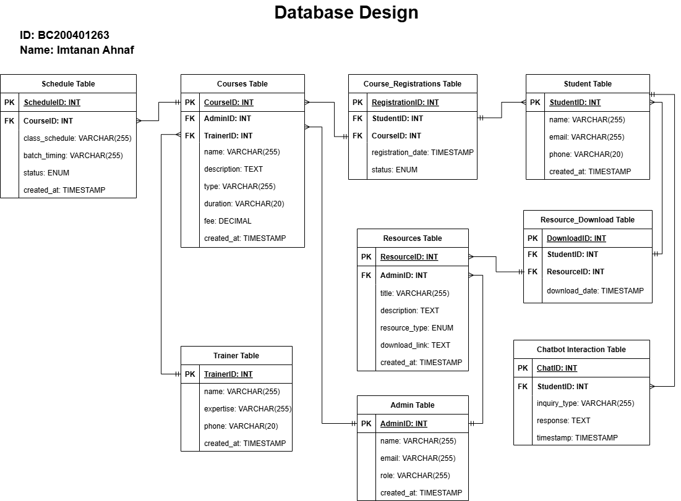

Slide 14
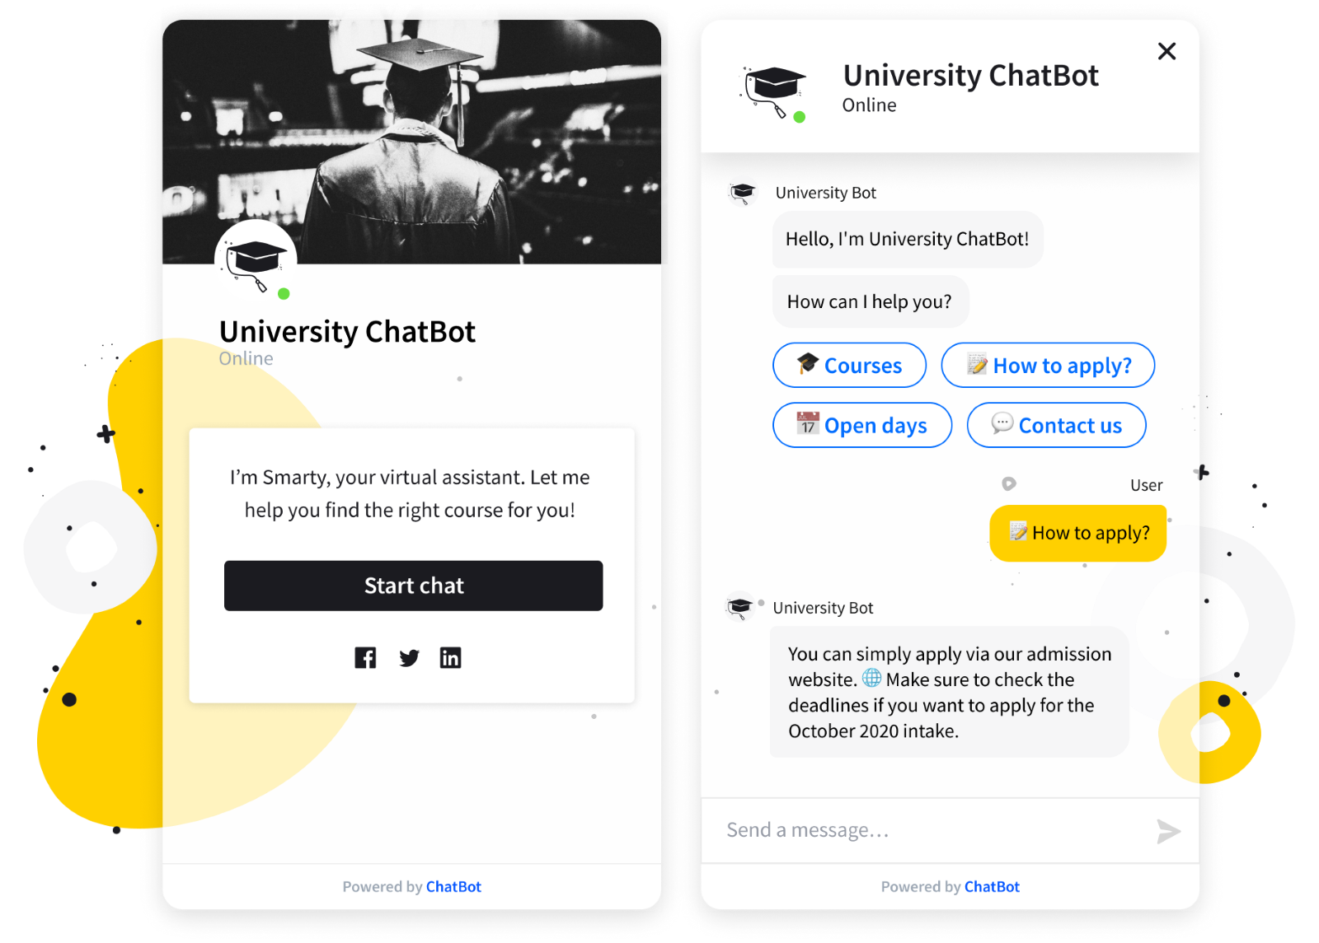
Interface Design

Slide 15
Tools and Technologies
Followings:
Frontend: 1- HTML 2- CSS 3- JS
4-Bootstrap
Backend: 1- PHP Language
Database: 1- MySQL (XAMPP Server)
Chatbot: 1- Dialogflow Platform

Slide 16
Thank You
Imtanan Ahnaf
BC200401263
bc200401263@vu.edu.pk

